Slide 1
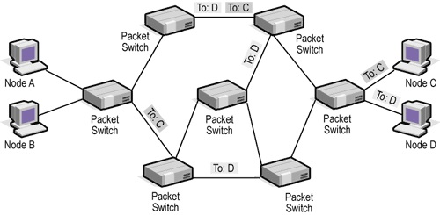
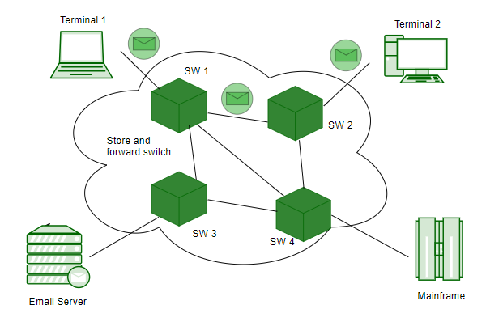
Chapter 8
Switching
Circuit-Switched Networks
Datagram Networks
Virtual-Circuit Networks
Structure of a Switching Device
8-<number>

Slide 2
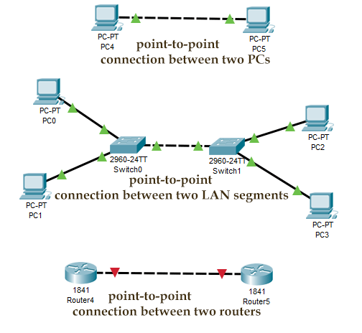
Network
8-<number>

Slide 3
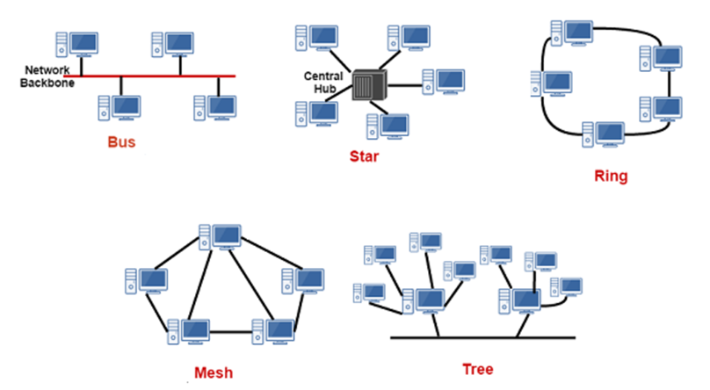
Multi-point Network
8-<number>

Slide 4

Switching
Switches are devices capable of creating temporary connections between two or more devices linked to the switch
8-<number>

Slide 5

Taxonomy of Switched Networks
8-<number>

Slide 6

Switching on TCP/IP and OSI Layers
8-<number>

Slide 7

Circuit-switched Network
A circuit-switched network is made of a set of switches connected by physical links, in which each link is divided into n channels
In circuit switching, the resources need to be reserved during the setup phase; the resources remain dedicated for the entire duration of data transfer until the teardown phase.
8-<number>

Slide 8

Circuit-Switched Network: Example 1
8-<number>

Slide 9

Circuit-Switched Network: Example 2
8-<number>

Slide 10
Circuit Switching
Three phases
  Setup phase, data transfer phase, teardown phase
8-<number>

Slide 11

Circuit Switching
Efficiency
Delay in a circuit-switched network
8-<number>

Slide 12
Packet Switching
8-<number>
Notes:
Welcome back class to week 3, we are discussing ch 8 Switching in networks, im your teacher hasan shah
Last week we discussed the circuit switched networks this week we will see ho packet switched networks send data. Therefore first we will talk about the packet switched networks a intro, so lets start packet switching

Slide 13

Datagram Networks
In a packet-switched network, there is no resource reservation; resources are allocated on demand
In a datagram network, each packet is treated independently of all others. Sometimes referred to as connectionless networks
8-<number>

Slide 14

Routing Table
A switch in a datagram networks uses a routing table that is based on the destination address
The destination address in the header of a packet in a datagram network remains the same during the entire journey of the packet
8-<number>

Slide 15

Delay in a Datagram Network
Datagram network may have greater delay than a virtual-circuit network even though no setup and teardown phase
Delay is not uniform
8-<number>

Slide 16

Delay in a Datagram Network
3T – Transmission delay
- - Propagating delay
W– Wait time at each router (switching element)
8-<number>

Slide 17
Virtual-Circuit Networks
Setup, data transfer, and teardown phases as in a circuit-switched network (CSN)
Resource allocated during setup phase, as in a CSN, or on demand as in a datagram network (DN)
As in DN, data are packetized and each packet carries an address in the header. The address has local jurisdiction, not end-to-end jurisdiction.
As in CSN, all packets follow the same path established during the connection
VCN is normally implemented in the data link layer, while CSN is in physical layer and DN in the network layer
8-<number>

Slide 18

Virtual-Circuit Network
8-<number>

Slide 19

Addressing
Two types of addressing in a virtual-circuit network: global and local (virtual-circuit identifier: VCI)
Global address is used only to create a VCI
Virtual Circuit Identifier
8-<number>

Slide 20

Three Phases
Data transfer phase, setup phase, teardown phase
Switch and tables in a virtual-circuit network
8-<number>

Slide 21

Data Transfer Phases
Source-to-destination data transfer in a virtual-circuit network
8-<number>

Slide 22

Setup Phases: Setup Request
8-<number>

Slide 23

Setup Phases: Acknowledgement
8-<number>

Slide 24


Delay in a Virtual-Circuit Network
In virtual-circuit switching, all packets belonging to the same source and destination travel the same path; but the packets may arrive at the destination with different delays if resource allocation is on demand.
8-<number>

Slide 25
Message Switching
This technique was somewhere in middle of circuit switching and packet switching.
In message switching, the whole message is treated as a data unit and is switching / transferred in its entirety.
A switch working on message switching, first receives the whole message and buffers it until there are resources available to transfer it to the next hop.
If the next hop is not having enough resource to accommodate large size message, the message is stored and switch waits.
8-<number>

Slide 26
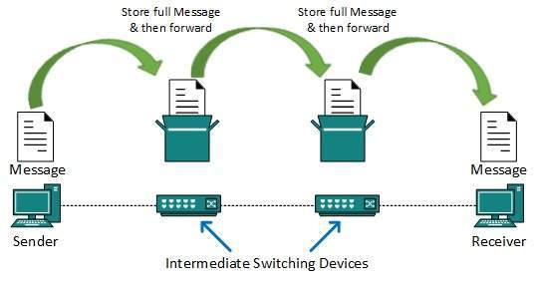
Message Switching conti..
This technique was considered substitute to circuit switching. As in circuit switching, the whole path is blocked for two entities only. Message switching is replaced by packet switching.
Message switching has the following drawbacks:
  Every switch in transit path needs enough storage to accommodate entire message.
  Because of store-and-forward technique and waits included until resources are available, message switching is very slow.
  Message switching was not a solution for streaming media and real-time applications.
8-<number>

Slide 27

Structure of Circuit Switches
Space-division switch or time-division switch
Space-division: crossbar switch, multistage switch
8-<number>

Slide 28
Crossbar Switches: Problem
The number of switches is huge.
  connect n inputs by m output -- require n * m crosspoint.
  Ex : 1000 input, 1000 output → 1,000,000 crosspoint
Inefficient
  fewer than 25% of the crosspoints are in use at a given time.
8-<number>

Slide 29

Multistage Switch
Solution to the limitation of the crossbar switch
8-<number>

Slide 30
Design of a Three-Stage Switch
Three steps
  Divide the N input lines into groups, each of n lines. For each group, use one crossbar of size n x k, where k is the number of crossbars in the middle stage
  Use k crossbars, each of size (N/n) x (N/n) in the middle stage
  Use N/n crossbars, each of size k x n at the third stage
N/n(n x k) + k(N/n x N/n) + N/n(k x n) = 2kN + k(N/n)²
In a three-stage switch, the total number of crosspoints is 2kN + k(N/n)² which is much smaller than the number of crosspoints in a single-stage switch (N²).
8-<number>

Slide 31
Multistage Switch: Example 1
Design a three-stage, 200 × 200 switch (N = 200) with k = 4 and n = 20.
In the first stage we have N/n or 10 crossbars, each of size 20 × 4. In the second stage, we have 4 crossbars, each of size 10 × 10. In the third stage, we have 10 crossbars, each of size 4 × 20. The total number of crosspoints is 2kN + k(N/n)², or 2000 crosspoints. This is 5 percent of the number of crosspoints in a single-stage switch (200 × 200 = 40,000).
8-<number>

Slide 32
Multistage Switches: Blocking
Advantage: The number of crosspoints
Disadvantage: blocking
Clos criterion: condition of nonblocking
  n = (N/2)^{1/2}
  k > 2n – 1
  Crosspoints ≥ 4N [(2N)^{1/2} – 1]
8-<number>

Slide 33
Multistage Switch: Example 2
Redesign the previous three-stage, 200 × 200 switch, using the Clos criteria with a minimum number of crosspoints.
.
We let n = (200/2)^{1/2}, or n = 10. We calculate k = 2n − 1 = 19. In the first stage, we have 200/10, or 20, crossbars, each with 10 × 19 crosspoints. In the second stage, we have 19 crossbars, each with 10 × 10 crosspoints. In the third stage, we have 20 crossbars each with 19 × 10 crosspoints. The total number of crosspoints is 20(10 × 19) + 19(10 × 10) + 20(19 ×10) = 9500.
8-<number>

Slide 34
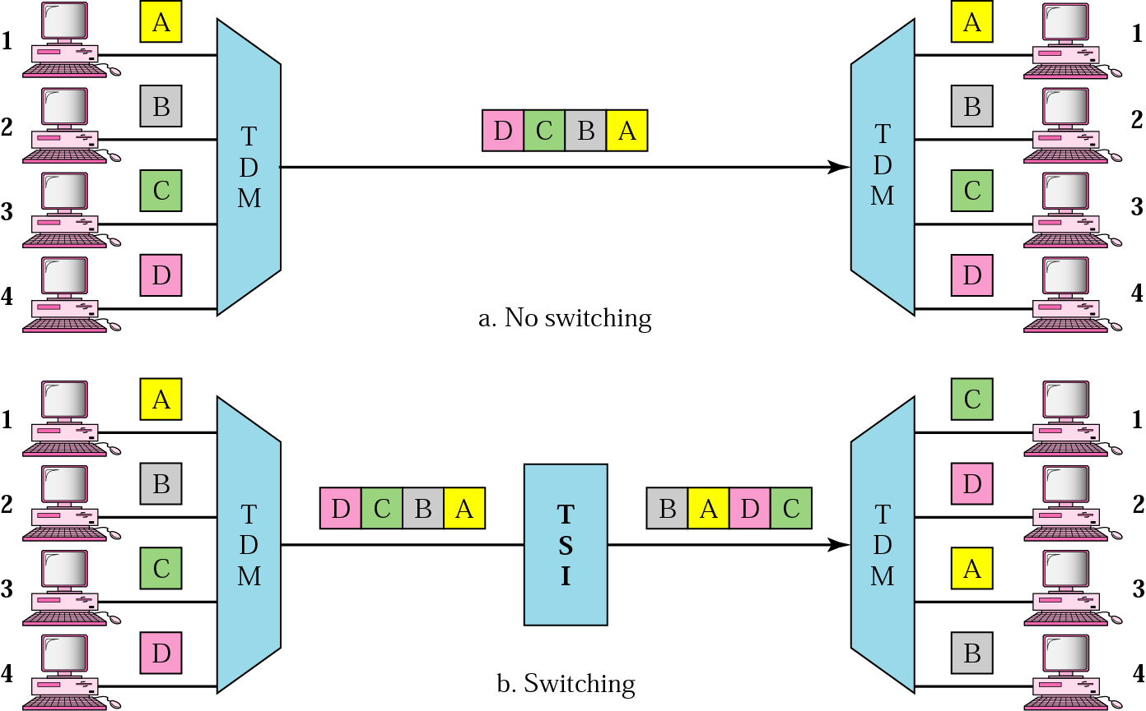
TDM, with and without TSI
8-<number>

Slide 35

Time-Slot Interchange
8-<number>

Slide 36
Time- and Space-Division Switch Combination
Space division: instantaneous, crosspoints
Time division: no crosspoint, processing delay
Space-and time-division switching combinations take advantage of the best of both
  TST(time-space-time)
  TSST(time-space-space-time)
  STTS(space-time-time-space)
8-<number>

Slide 37
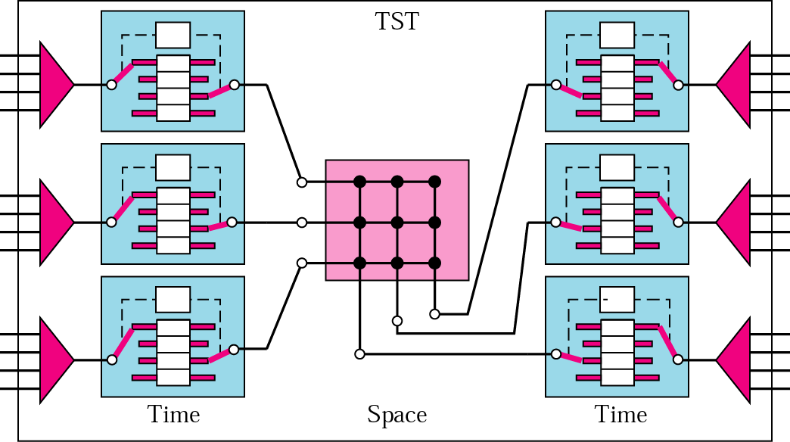
TST Switch
8-<number>

Slide 38

Structure of Packet Switch
Four components: input port, output port, routing processor, switching fabric
8-<number>

Slide 39


Input/Output Port
8-<number>

Slide 40
Structure of Packet Switch
Routing processor: network layer functions
  Table lookup: searching the routing table by destination address
Switching Fabric
  Crossbar switch
  Banyan switch
  Batcher-Banyan switch
8-<number>

Slide 41

Banyan Switch
Multistage switch with microswitches at each stage that route the packets based on the output port represented as a binary string
8-<number>

Slide 42

Example of Routing in a Banyan Switch
8-<number>

Slide 43

Batcher-Banyan Switch
Problem in Banyan switch: possibility of internal collision
  Solve it by sorting the arriving packets based on their destination port
8-<number>

